Slide 1
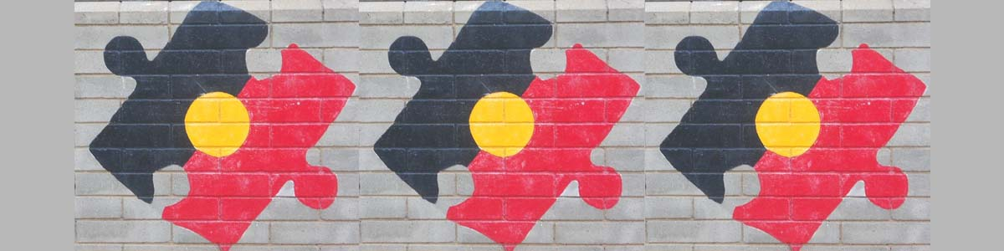
INDG6002
Week 1 - Tutorial
Contrasting Indigenous and western health perspectives

Slide 2
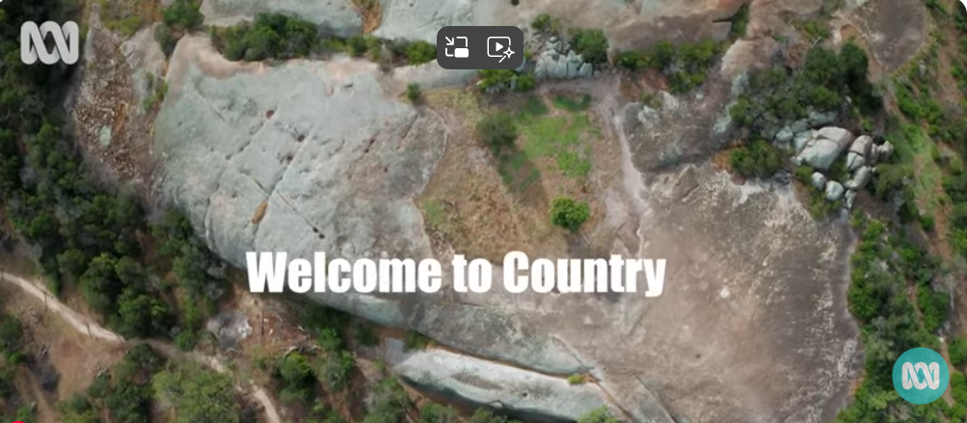
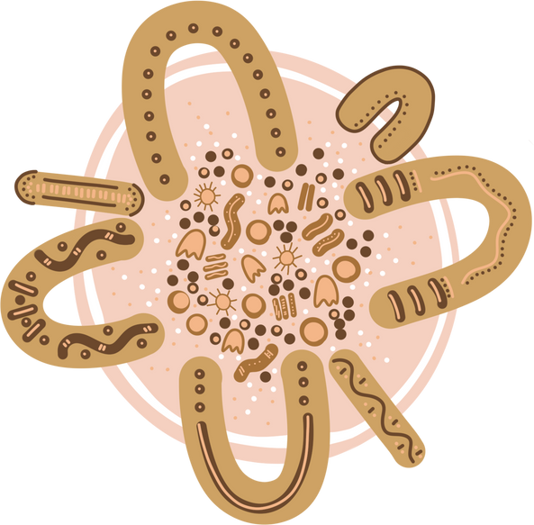
Welcome to Country
https://www.youtube.com/watch?v=DAGBVE3V4s0

Slide 3
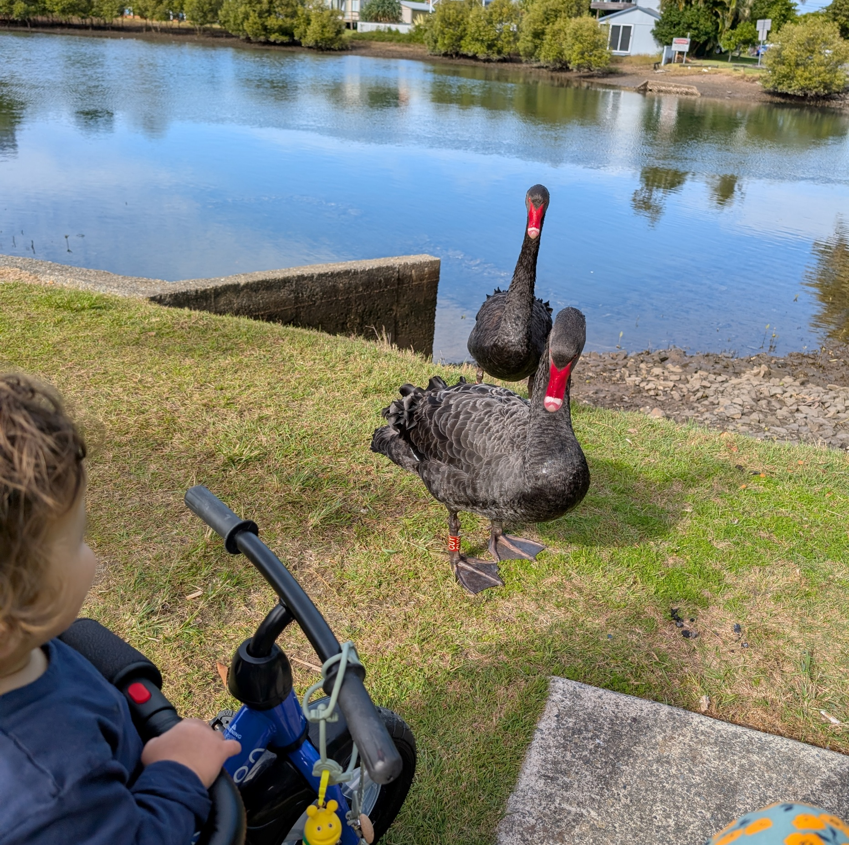
Acknowledgment of Country
An Acknowledgement of Country is a demonstration of respect for the Traditional Caretakers of the land on where we Yarn today.
It is a recognition of the continuing relationship between Aboriginal and Torres Strait Islander peoples and their Country; acknowledging their continuing connections to land, sea and community.

Slide 4
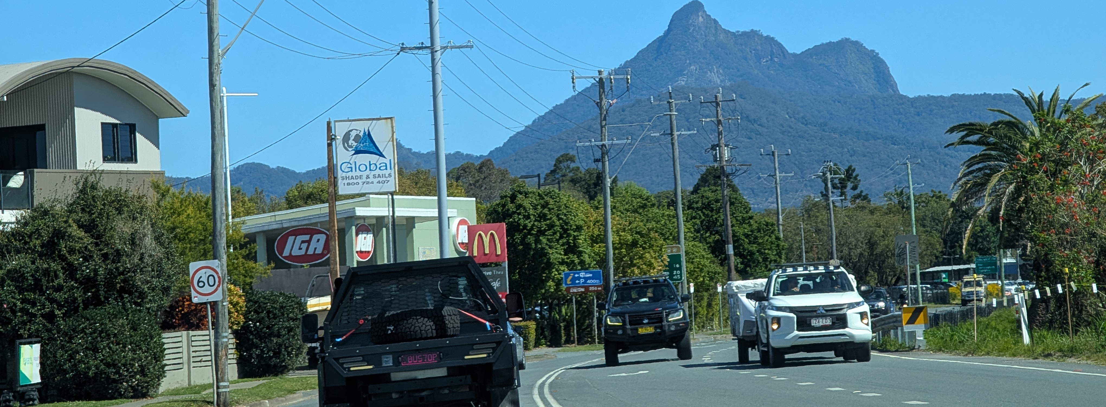
Acknowledgment of Country

Slide 5
Warning
Aboriginal and Torres Strait Islander students are advised that the following content may contain the images and stories of Aboriginal Elders and community members now resting in the Dreaming

Slide 6


Welcome - overview
In this first module we will explore the divergent concepts of health and provide a deeper understanding of the wholistic and multi-factorial view of health and wellbeing through an Aboriginal and Torres Strait Islander lens
The Social and Emotional Wellbeing framework is introduced
Dadirri (deep non-judgemental listening) and Yarning are introduced
Change of focus and narratives towards strengths-based approaches

Slide 7
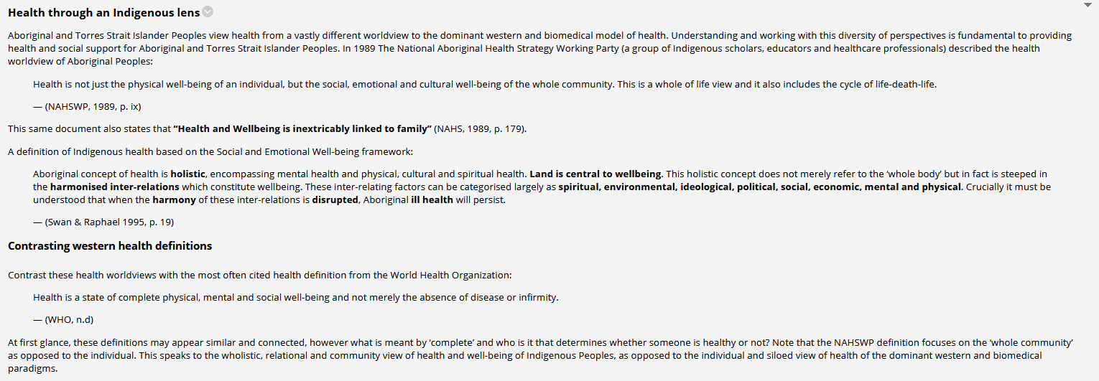
TIP …

Slide 8
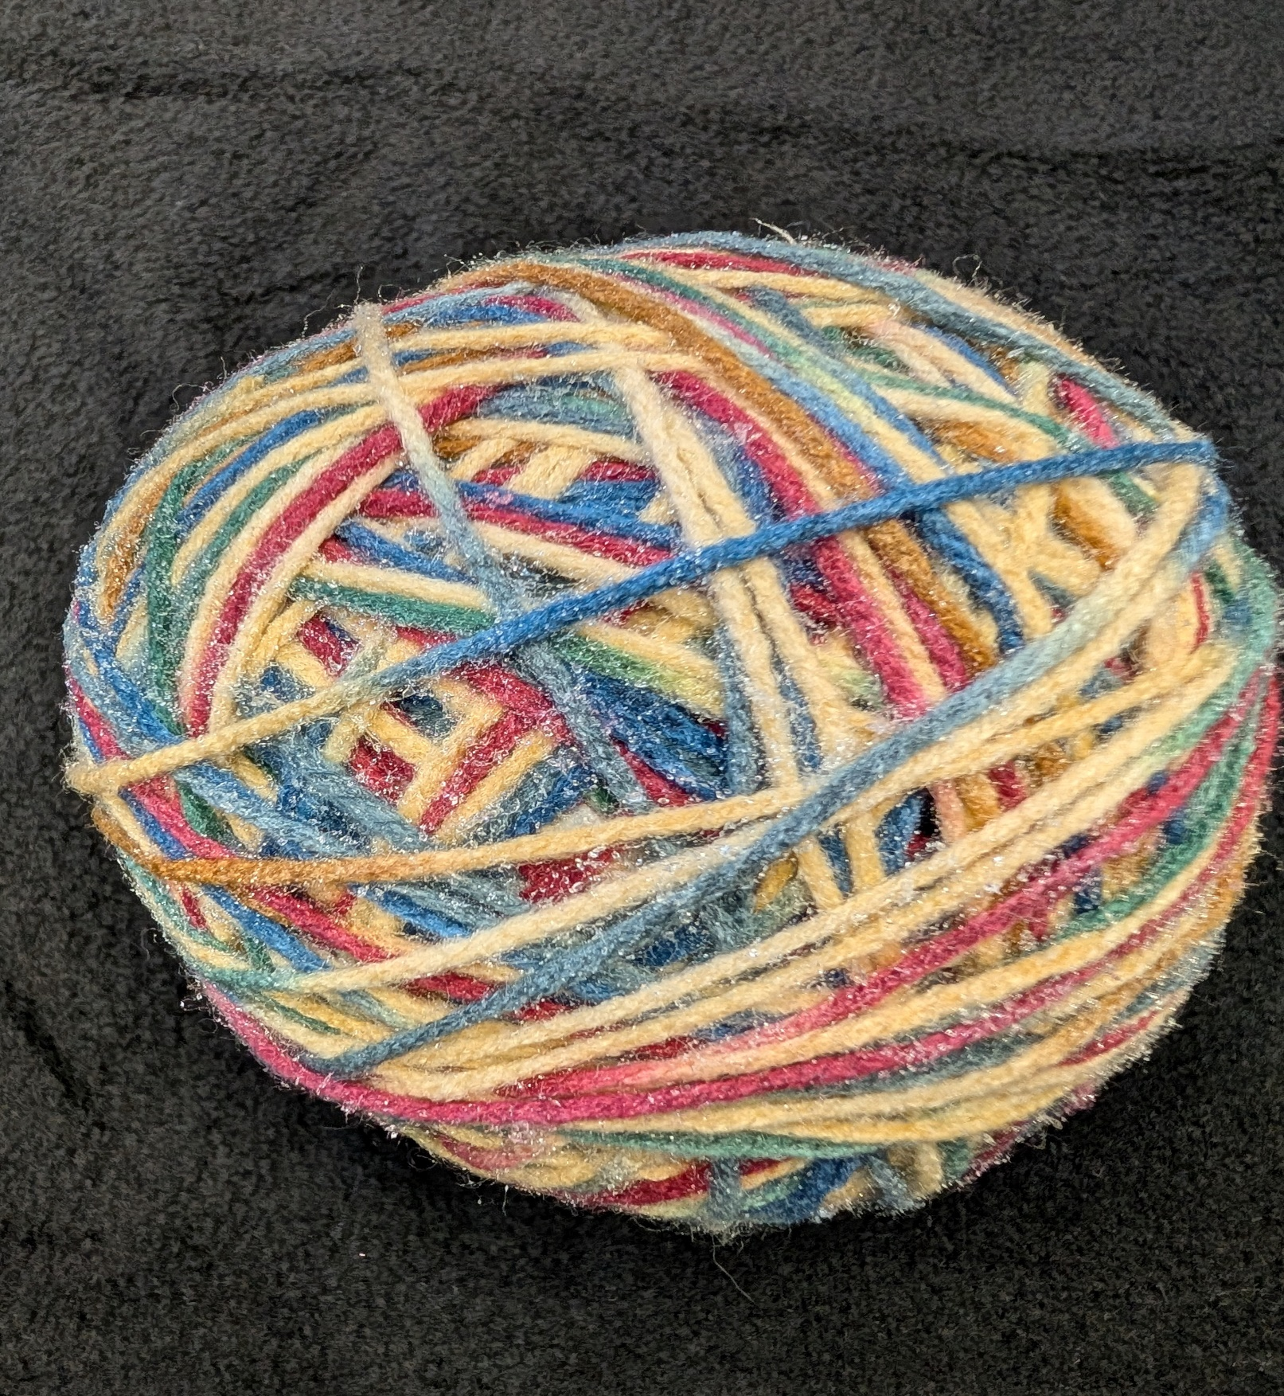
A symbol of Interconnectedness and Timelessness
A symbol of interconnectedness—each flows into the next, representing the interwoven nature of Country, people, animals, plants, Ancestors, and spirit. We are reminded that everything is connected through Country.
Its round shape reflects non-linear time: past, present, and future exist together, guided by the Dreaming.
It reminds us that everything is connected, and our stories are always alive.
The colours shift and shimmer like the land itself—Holding this ball is like holding a piece of the Dreaming. It invites us to listen, to learn, and to walk gently with respect for all beings—seen and unseen, past and present.

Slide 9

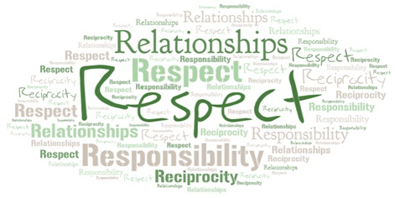
4 R’s Differences but Commonalities

Slide 10
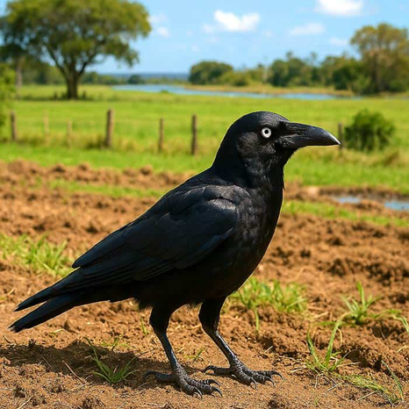
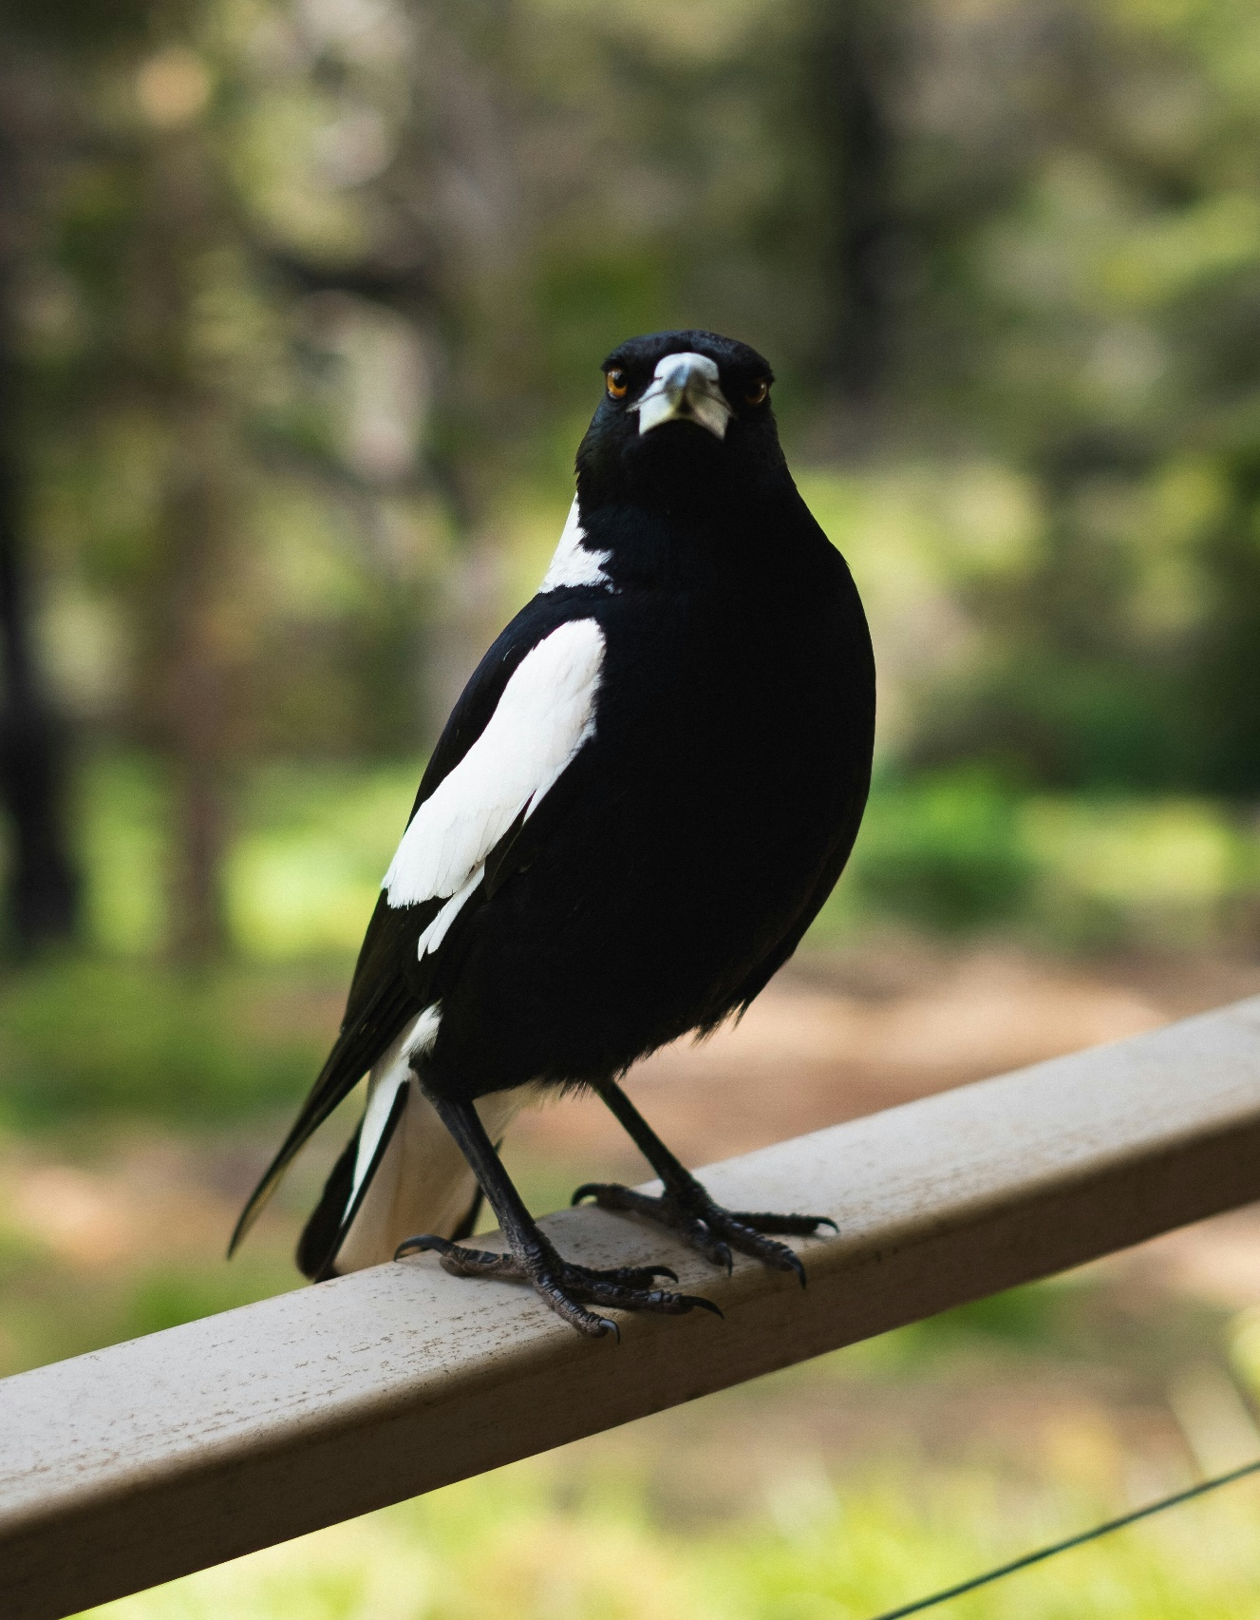

Magpie Story – Differing worldviews
Magpie Image: A bird standing on a railing photo – Free Bird Image on Unsplash
Story shared by Nicole Tujague & Kelleigh Ryan, 2023, p. 47
Crow Image: Torresian Crow | Corvus orru | Black Bird | BioExplorer

Slide 11
A symbol of Interconnectedness and Timelessness
A symbol of interconnectedness—each flows into the next, representing the interwoven nature of Country, people, animals, plants, Ancestors, and spirit. We are reminded that everything is connected through Country.
Its round shape reflects non-linear time: past, present, and future exist together, guided by the Dreaming.
It reminds us that everything is connected, and our stories are always alive.
The colours shift and shimmer like the land itself—Holding this ball is like holding a piece of the Dreaming. It invites us to listen, to learn, and to walk gently with respect for all beings—seen and unseen, past and present.

Slide 12
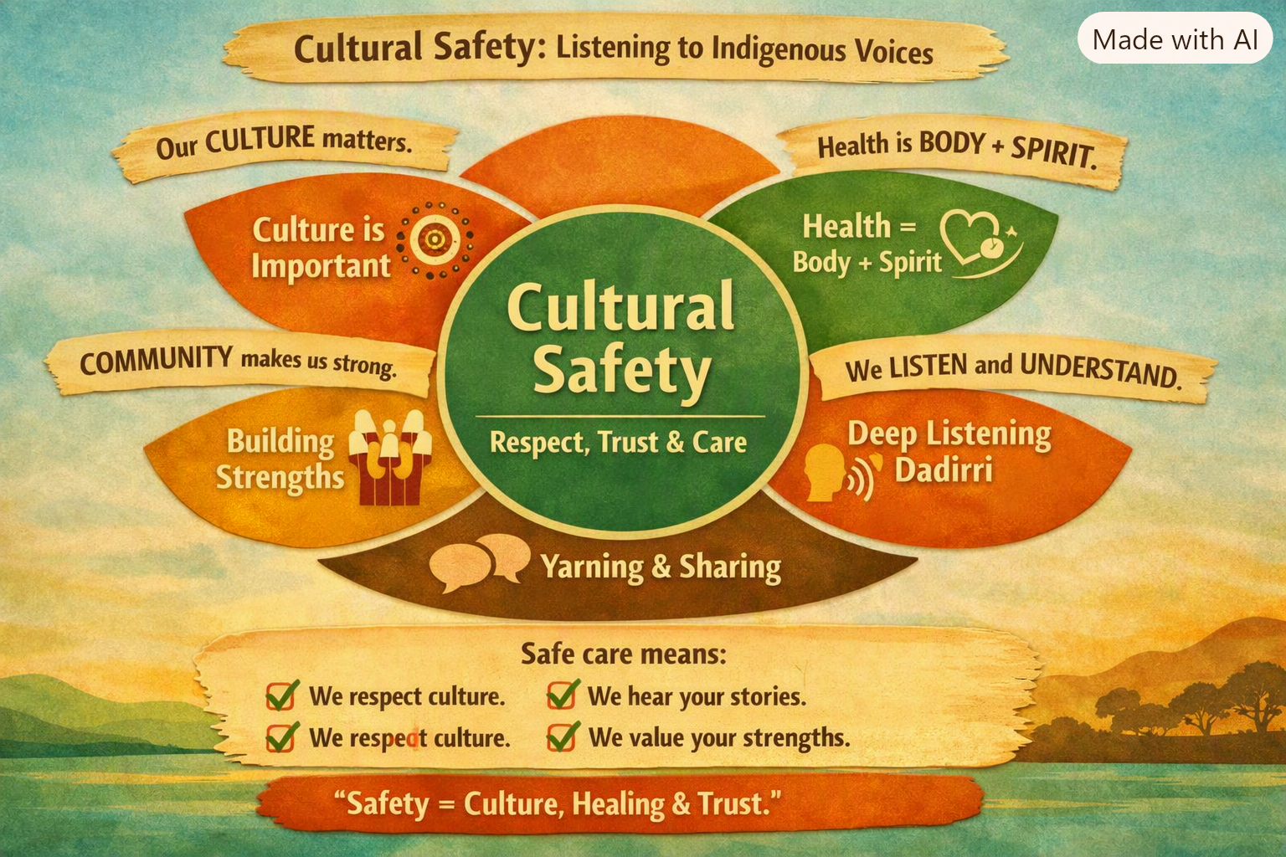
Mapping Module to grass-roots, community-led Indigenous frameworks and approaches
Australian Institute of Health and Welfare (AIHW) 2023 – Cultural Safety in Health Care for Indigenous Australians: Monitoring Framework

Slide 13

Yarning is Australian First Nations People’s storytelling based on reciprocal relationships where respect is assumed.
Acknowledgement of the powerfulness of mother earth and her connections to the people who have reciprocal responsibilities with her
One day return to Country. The feelings of sadness were profound.
His ancestors were part of him and were communicating with him. This experience confirmed all he knew about his tribal ways, his epistemology, axiology and ontology. It was now time to return to Country

Slide 14
Models of health
World Health Organisation (1948) definition:
Health is a state of complete physical, mental and social well being and not merely the absence of disease or infirmity.
National Aboriginal Health Strategy (1989) definition:
Health is not just the physical wellbeing of the individual, but the social, emotional and cultural wellbeing of the whole community. This is a whole-of-life view and it also includes the cycle of life-death-life

Slide 15
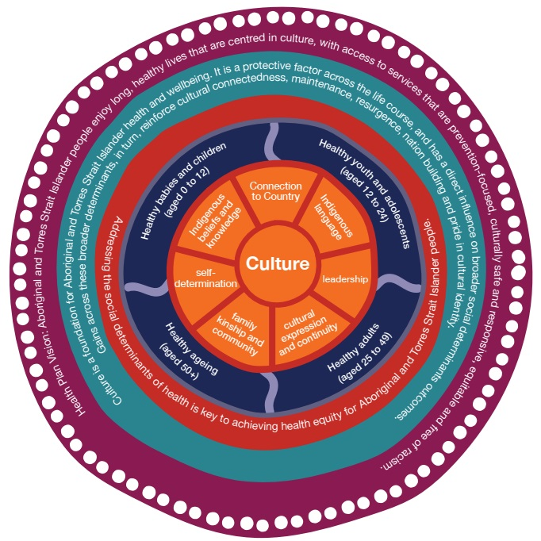
Current Health Plan vision …

Slide 16
Another definition of health
Land is central to wellbeing:
This holistic concept does not merely refer to the ‘whole body’ but, in fact, is steeped in the harmonised inter-relations which constitute wellbeing. These inter-relating factors can be categorised largely as spiritual, environmental, ideological, political, social, economic, mental, and physical. Crucially it must be understood that when the harmony of these inter-relations is disrupted, Aboriginal ill health will persist.
(Swan & Raphael 1995, pt1, p.13 cited in Taylor & Guerin 2014, p. 106)

Slide 17
“Health is so much more than simply not being sick. It’s about getting a balance between physical, mental, emotional, cultural and spiritual health. Health and healing are interwoven, which means that one can’t be separated from the other .”
Dr Tamara Maclean, Australian First Female Aboriginal Doctor

Slide 18
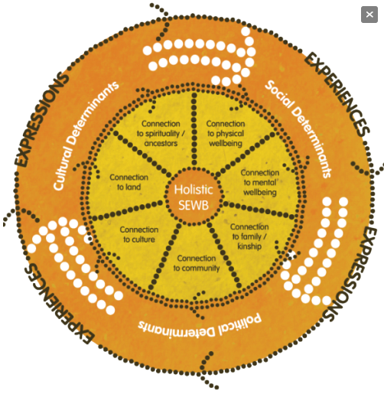
(361) Social and Emotional Wellbeing - Indigenous point of view - YouTube
This model was developed during the Ways Forward National Consultancy (Swan, P & Raphael B., 1995)
Image sourced from the National Strategic Framework for Aboriginal and Torres Strait Islander's Peoples’ Mental Health and Social Emotional Wellbeing

Slide 19
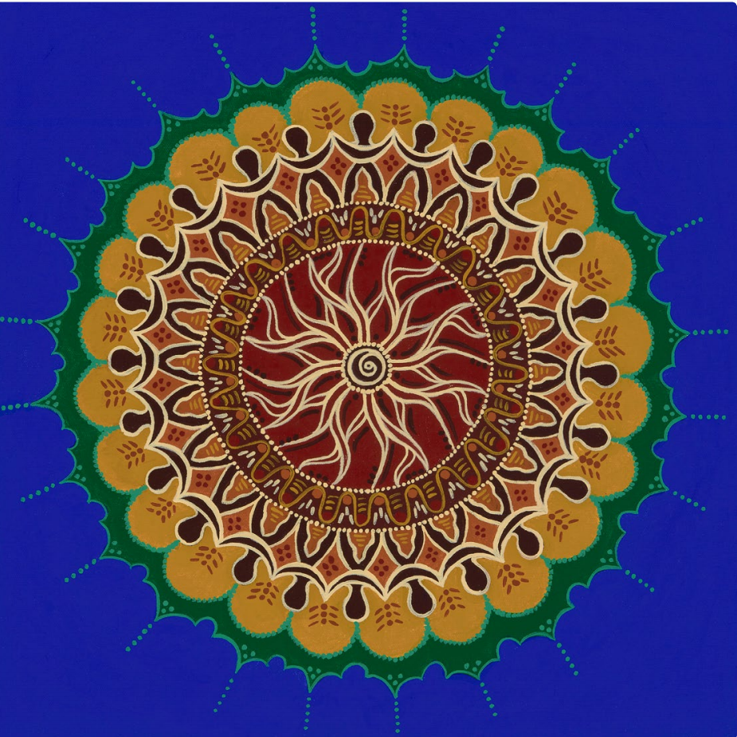
Nine guiding principles that underpin the SEWB Framework
These principles emphasise the holistic and whole-of-life definition of health held by Aboriginal and Torres Strait Islander Peoples.
Health is holistic
The right to self determination
The need for cultural understanding
The impact of history in trauma and loss
Recognition of human rights
The impact of racism and stigma
Recognition of centrality of kinship
Recognition of cultural diversity
Recognition of cultural strengths
These principles were developed during the Ways Forward National Consultancy (Swan, P & Raphael B., 1995)
Image sourced from the National Strategic Framework for Aboriginal and Torres Strait Islander's Peoples’ Mental Health and Social Emotional Wellbeing.

Slide 20
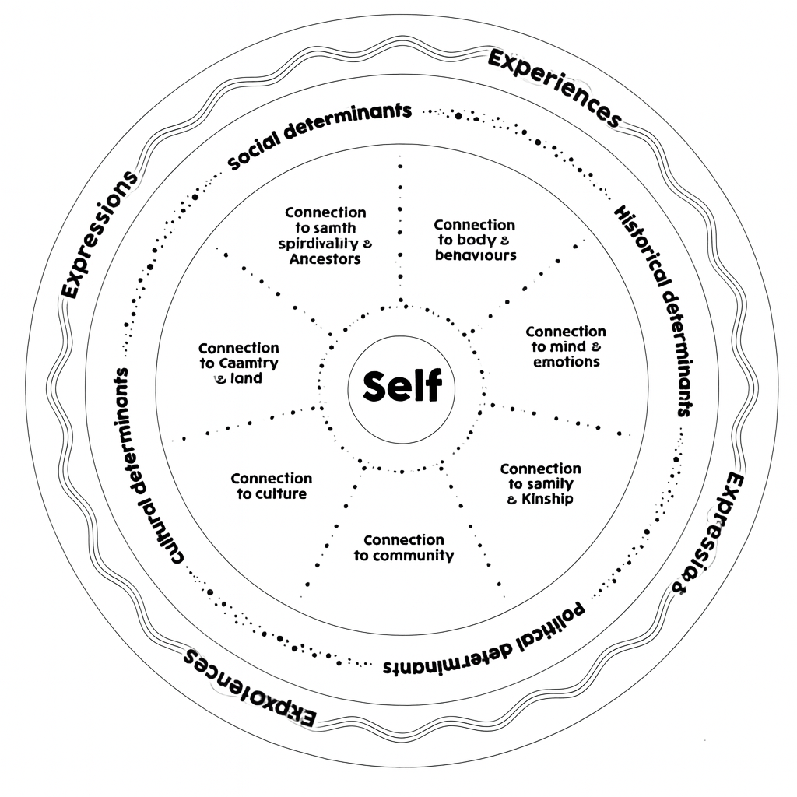
Activity: Using the Wellbeing circle for a check-in
What is important to you? Break the circle up to represent what is important to you and your wellbeing
How satisfied are you in these areas? Shade each area to represent how satisfied you feel in these areas
What do you feel has allowed you to feel the levels of satisfaction that you have indicated in each area?
What do you feel is currently stopping you from feeling more satisfied in each of these areas?
What would you like to see change?
How would you like to see these changes occur?

Slide 21
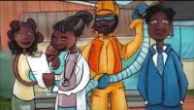
Journey of Health and Wellbeing
(361) Journey of health and wellbeing - YouTube

Slide 22
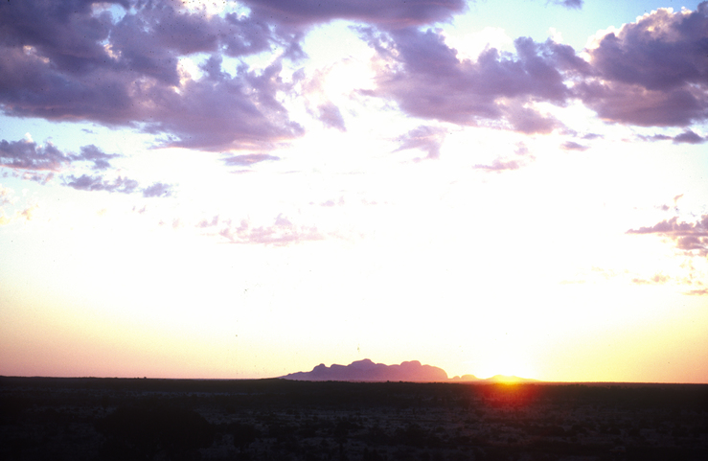
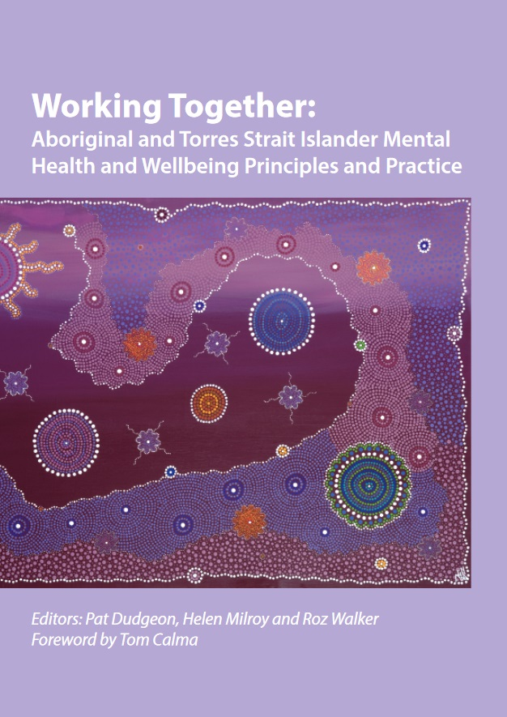
Examples of risks to Aboriginal SEWB
Discrimination and Race
Widespread grief and loss
Unresolved trauma
Life stress
Social exclusion
Economic and social disadvantage
Incarceration and juvenile justice supervision
Child removal by Care and Protection Orders
Violence
Family violence
Substance use
Physical health problems
(Zubrick et al., 2014)

Slide 23
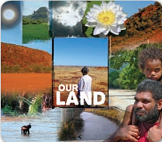
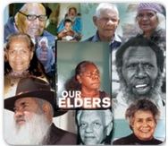
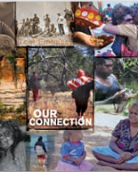
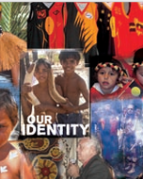
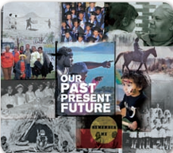
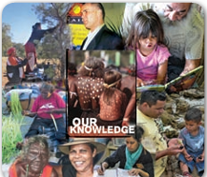
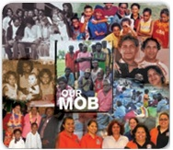
Strengths-based approach

Slide 24

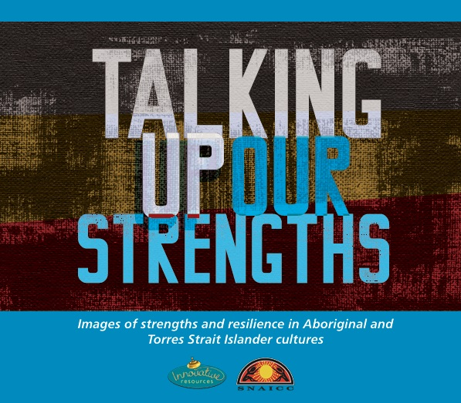
Strengths Based Activity
Talking Up Our Strengths Cards
Instructions:
🎴 Select a card. Choose one ‘Talking Up Our Strengths’ card that resonates with you.
🧑‍🤝‍🧑 Discuss in your group. Share how the strength you chose shapes your view or actions within your own culture.
🌏 Reflect on cultural insights. Explore: Did your card or group discussion show similarities or differences between your cultural group and Aboriginal and Torres Strait Islander peoples and their cultures?
📢 Share with the whole class. Highlight insights from your group—what surprised you, moved you, or made you think?

Slide 25
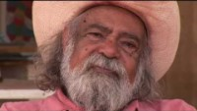
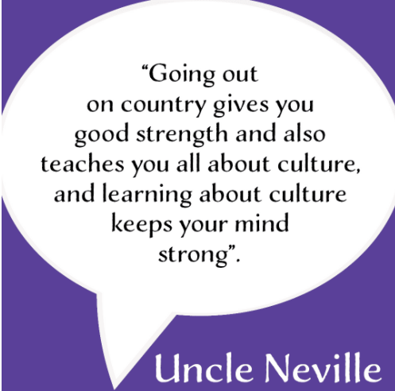
Factors that protect Aboriginal SEWB
Connection to Land, culture, spirituality and ancestry
Kinship
Self-determination, Community Governance, and Cultural Continuity
The land owns us…
‘Tjilpi’ Uncle Bob Randall from Kanyini Unconditional Love and Responsibility
(Zubrick et al.,2014)
Uncle Neville quote retrieved from Social & Emotional Wellbeing - HealthWISE (healthwisenenw.com.au)

Slide 26
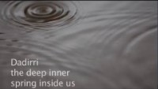
Strength-based Method
Dadirri

Slide 27
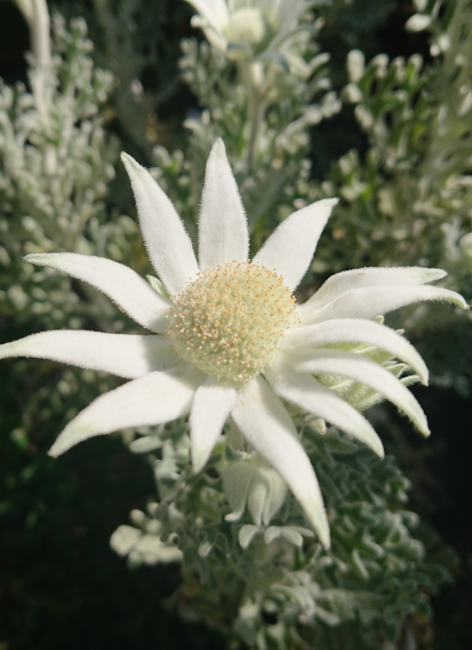
Yarning
Yarning is a word used by many Aboriginal and Torres Strait Islander people, meaning ‘Let’s have a chat’ (Bessarab, 2010).
Use of minimal questions and prompts, with acute listening skills are fundamental to allowing comfortable and informal stories and discussions to unfold.
Do not interrupt, this shows lack of respect for what is being shared
Take on the role of listener, learner, and student

Slide 28
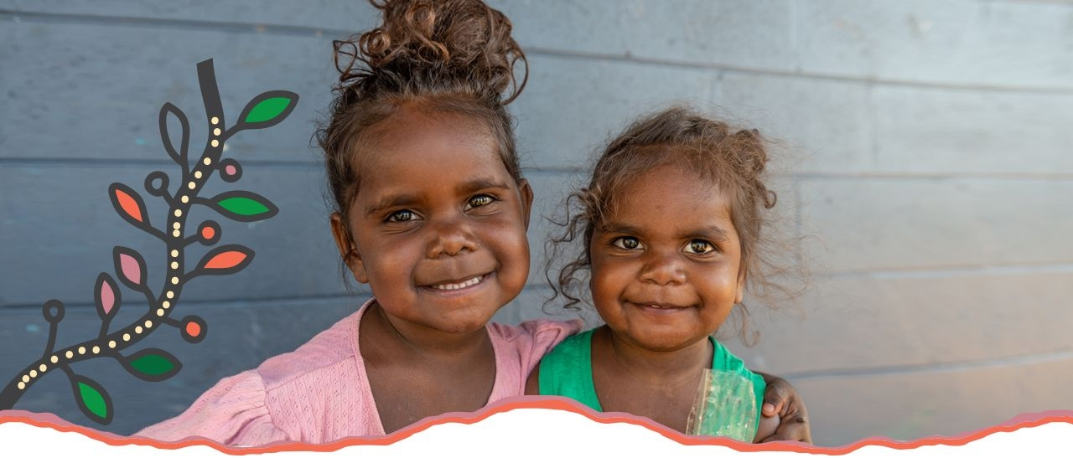
Waijungbah Jarjums
Birthing on Country
Why it matters:
Holistic SEWB: Health includes emotional, cultural, spiritual, and community wellbeing.
Country as wellbeing: Identity, belonging, and healing come from Country.
Yarning & Dadirri: Culturally safe communication builds trust.
Indigenous worldviews: Health is relational and community‑centred.
Strengths‑based practice: Focus on culture, resilience, identity, and community strength.
Contrast with Western models: Moves beyond physical health to whole‑of‑life wellbeing.
What happened:
Yugambeh community created a Birthing on Country program.
Indigenous midwives, Elders, and health workers lead the model.
Care includes Yarning, cultural mentoring, and family involvement.
Babies are welcomed to Country through ceremony.
Women receive continuity of care and cultural support.
https://www.goldcoast.health.qld.gov.au/our-services/aboriginal-and-torres-strait-islander-service/services/waijungbah-jarjums

Slide 29
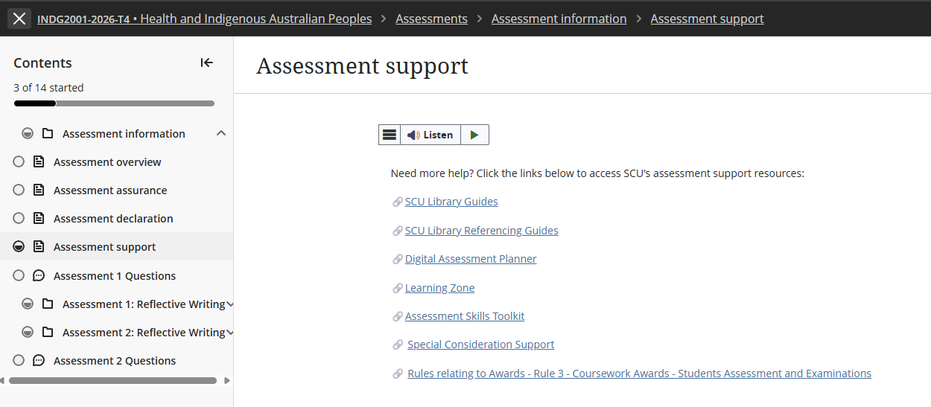
Special Considerations Support extension

Slide 30
Assessment 1 – Short Response
Title | Assessment 1
Type | Short response
Length | 1,000 words
Weighting | 40%
Academic Integrity | Level 2. Purpose-Specific GenAI Use GenAI may NOT be used EXCEPT Grammarly Premium AI.
Submission | Word document submitted to Blackboard
Unit Learning Outcomes | This assessment task maps to the following ULOs: ULO1: Discuss key concepts of health and wellbeing as determined by Aboriginal People. ULO2: Identify key stages of the colonisation process and its relationship to the contemporary health status of Australian Indigenous People.

Slide 31
Overview to Writing a Short Response
Always use unit approaches (concepts, theories, models, processes or guidelines) in your short responses. Often, this means defining and applying unit concepts or theories.
Before you start working on the assessment, find definitions in the unit materials. This step will help you gain a more detailed grasp of unit ideas and theories so that you can show this understanding to the marker.
Don't try to COVER EVERYTHING you know about a topic. While it can be tempting, this is not your task in a short response, and you don't have enough words. Offer your informed answer to the question within a limited word count.
As you brainstorm, plan, and draft keep trying to narrow, narrow, narrow your focus.
You can use headings in a short response, it is part of the word count.

Slide 32
10 Key Steps for Strong Short Response Writing
Start with a clear main point: Emphasise that short responses must begin with the answer, not background. Example sentence starters such as: “This concept refers to…” or “In the scenario, this is evident when…”.
2. Explain the key concept briefly: Define or clarify the concept in their own words before applying it. This prevents vague or incorrect use of terms
3. Link the concept to UNDRIP Article 3
Show clearly how the concept relates to the rights described in Article 3 and to Australian Indigenous Peoples understandings of health and wellbeing. Interpret the connection—do not retell general background information.
4. Use scholarly or unit evidence: Short responses still require academic grounding. Evidence can be a unit concept, framework, or scholarly idea. Keep it brief.
5. Write concisely and coherently: Use short, direct sentences - improves clarity and reduces grammatical errors - avoid long introductions, unnecessary detail, or narrative writing.

Slide 33
10 Key Steps for Strong Short Response Writing continued …
6. Maintain respectful terminology: Remember: Correct and consistent use of your chosen term
7. Conclude by linking back to the question: A final sentence should reinforce the main point to close the paragraph logically and signals relevance to the marker.
8. Avoid common pitfalls: Highlight typical issues: over‑description, missing the main point, unclear links to Article 3, lack of evidence, incorrect terminology, and overly long sentences.
9. Use postgraduate verbs: Encourage verbs that show analysis and interpretation: analyse, interpret, examine, integrate, contextualise. Discourage vague verbs like talk about or discuss.
10. Follow a simple structure (PEEL): Point → Explain → Evidence/Scenario → Link.

Slide 34
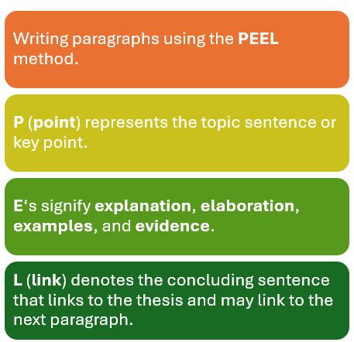
PEEL Writing Structure

Slide 35
Assessment 1 Overview
Purpose of the Assessment
Builds understanding of Australian Indigenous perspectives of health and wellbeing.
Introduces self‑determination as a core principle in UNDRIP Article 3.
Highlights differences between Australian Indigenous wholistic health and Western biomedical models.
Examines how colonisation has limited the ability to exercise self‑determination.
Develops foundational knowledge for culturally safe practice in health, social services, and community work.
Strengthens critical thinking and culturally grounded analysis for professional contexts.
Task Description
Read Article 3 of the United Nations Declaration on the Rights of Indigenous Peoples (UNDRIP):
"Indigenous peoples have the right to self-determination. By virtue of that right, they freely determine their political status and freely pursue their economic, social and cultural development."
Write a 1,000-word short response explaining how this article relates to Australian Indigenous Peoples understandings of health and wellbeing.

Slide 36
Assessment 1 Task Instructions
Step 1: Read UNDRIP Article 3
Consider what the term self-determination means and why it is important for Australian Indigenous Peoples.
Step 2: Review Unit Content
Use learning materials from:
  Module 1: Australian Indigenous concepts of health and wellbeing.
  Module 2: Colonisation and its impacts on Australian Indigenous health and wellbeing.
Step 3: Research
Locate additional scholarly literature that supports your discussion.
  Definition of Scholarly and Peer-Reviewed sources
  Peer-reviewed sources are academic publications that have been evaluated by experts before publication to ensure quality, accuracy, and credibility. Scholarly sources are written by researchers or experts for an academic audience and include journal articles, academic books, conference papers, and theses. They typically provide author credentials and references. All peer-reviewed sources are scholarly, but not all scholarly sources are peer-reviewed. For example, an academic book may be scholarly without undergoing peer review.
Step 4: Write Your Response
Your response should explain how Australian Indigenous concepts of health and wellbeing, self-determination, and community-accepted communication styles are interconnected, and how these relate to the ongoing impacts of colonisation on Australian Indigenous health and wellbeing.

Slide 37
Example Short Response Structure
Introduction (Approx. 100 words)
Introduce UNDRIP Article 3.
Outline the main points of your response.
Health and Wellbeing (Approx. 300 words)
Examine the key concepts of health and wellbeing from Australian Indigenous perspectives.
Reflect on why self-determination is important for Australian Indigenous health and wellbeing.
Critically evaluate one cultural determinant which shapes Australian Indigenous health and wellbeing.
Community-accepted communication styles (Approx. 300 words)
Critically analyse the role of community-accepted communication styles in supporting Australian Indigenous health and wellbeing.
Colonisation and Health (Approx. 200 words)
Critically reflect on the enduring effects of colonisation on Australian Indigenous health and wellbeing.
Conclusion (Approx. 100 words)
Summarise your key points. NO new information

Slide 38
Your response must …
Assessment Requirements
Follow the Short Response Quick Guide (Assessment 1 resources).
Address UNDRIP Article 3 throughout your discussion.
Analyse Australian Indigenous concepts of health and wellbeing, including self‑determination and one cultural determinant.
Explain the relationship between colonisation and contemporary Australian Indigenous health outcomes.
Support your discussion with scholarly evidence.
Sources & Referencing
Use a minimum of five (5) scholarly sources.
UNDRIP must be cited and referenced, but does not count toward the five scholarly sources.
Your reference list must contain at least six (6) references in total.

Slide 39
Referencing Requirements
Ensure you meet the following Criteria:
Referencing style of APA7.
Consistent use of correct and appropriate terminology and tone in reference to Australian Indigenous Peoples health and wellbeing.
Use a minimum of 5 scholarly sources
You must also cite and reference UNDRIP (2007). As UNDRIP is not a scholarly source, it does not count towards the minimum of five scholarly sources.
  Therefore, your reference list must contain at least six (6) references.
Wikipedia, Creative Spirits and or other such websites are not acceptable scholarly reference material.

Slide 40
Other Requirements …
Ensure you have attached your signed and correctly completed Coversheet to the front of your assessment document prior to uploading your final submission.
Label your submission with your surname and initials, and the assessment task's name e.g. SmithJ_ShortResponse.docx
You are required to use APA 7th referencing style in this Unit formatting your document, citations, and references
Instead of a Header you MUST add a footer to your submission.
Add your name and task type – i.e. SmithJ_ShortResponse on left margin, your student ID, and have page number on the right margin e.g.

Slide 41
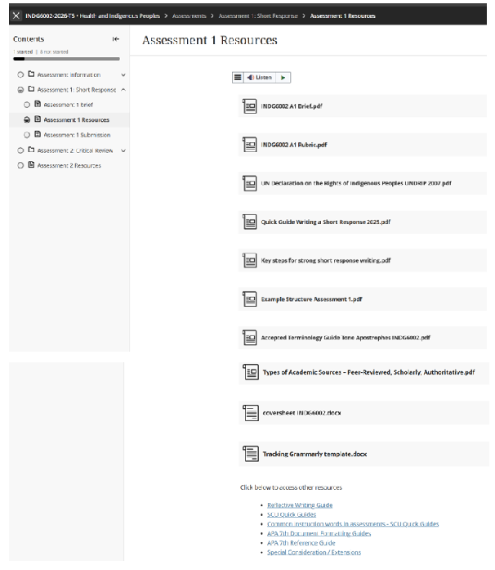
Assessment 1 – Resources & Other Requirements

Slide 42
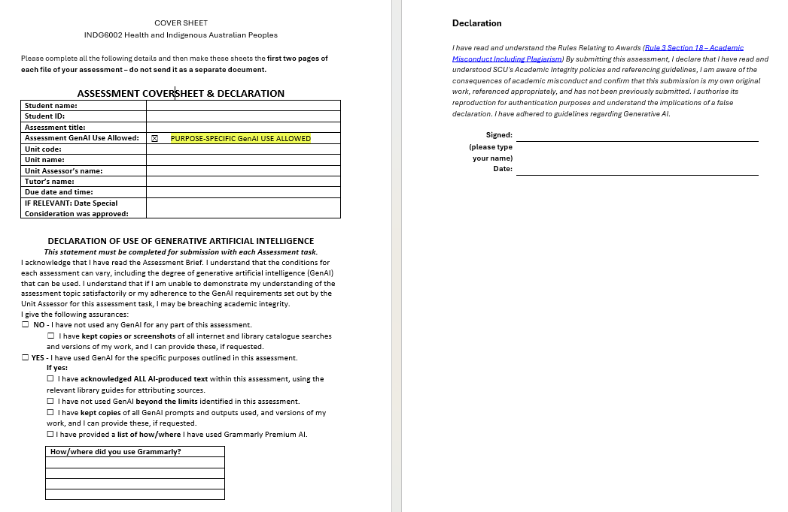
Assessment Coversheet & Declaration

Slide 43
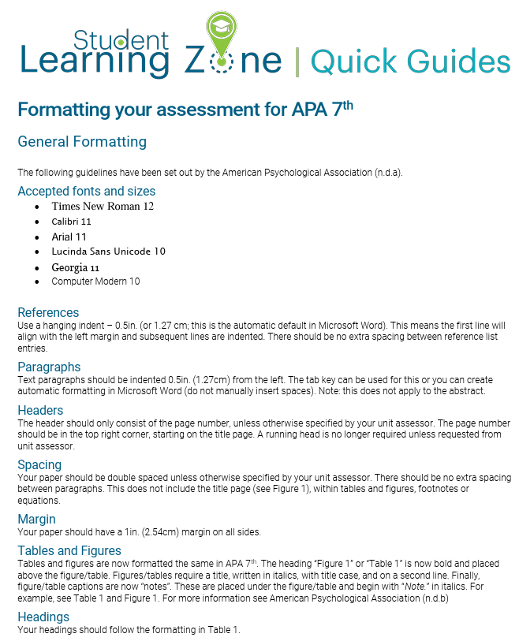
APA 7th Formatting your Document

Slide 44
INDG6002 - GenAI Use
In Gnibi College units, the use of GenAI in assessments is generally restricted to protect the integrity and authenticity of the learning process. Indigenous Knowledges are grounded in lived experience, cultural practices, and relational ways of knowing. Engaging meaningfully with these knowledges requires personal reflection, respectful interpretation, and a commitment to culturally responsive learning—something that cannot be authentically achieved through AI-generated content.

Slide 45
INDG6002 - GenAI Use continued …
This assessment is classified as:
Level 2: AI use permitted for specific purposes. You can use AI for specific tasks as identified by the Unit Assessor.
✅ You may use GenAI to:
Formatting, spelling and grammar - Grammarly Premium AI is permitted for formatting, spelling and grammar. Grammarly is permitted for language improvements – no content or knowledge creation is permitted.
Paraphrasing permitted - Use of Grammarly Premium AI is permitted for paraphrasing. Pay careful attention to any language adjustments that may affect the clarity of your work. Paraphrasing using Grammarly Premium AI must be referenced.
❌ You may not use GenAI to:
Use of any other GenAI for content or knowledge creation is not within the permitted uses for this task.
Present GenAI-generated material as your own original ideas
Ask GenAI to write any part of the analysis, commentary, or conclusions about your chosen study.
Upload or provide text from the research article or for GenAI to rewrite, summarise, or interpret the article.

Slide 46
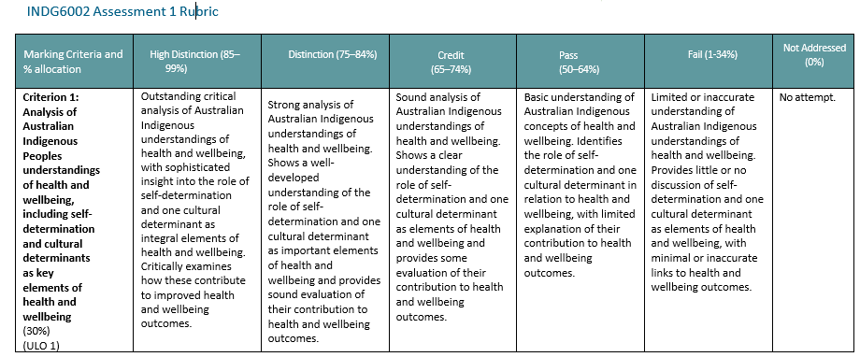
Rubric Assessment 1: Criterion 1

Slide 47
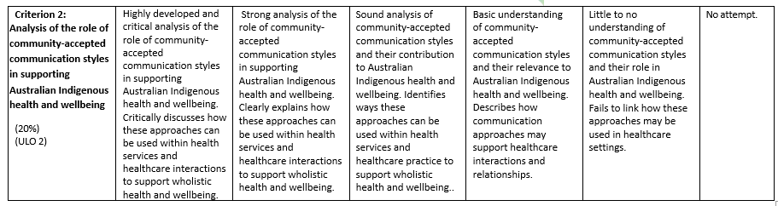
Rubric Assessment 1: Criterion 2

Slide 48
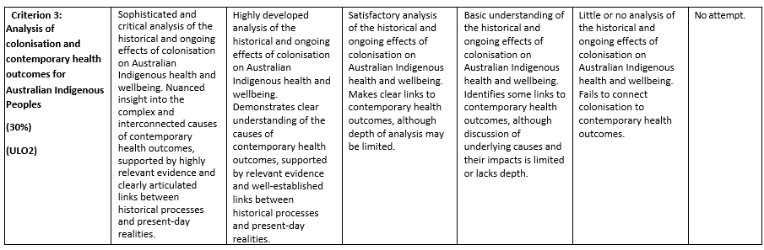
Rubric Assessment 1: Criterion 3

Slide 49
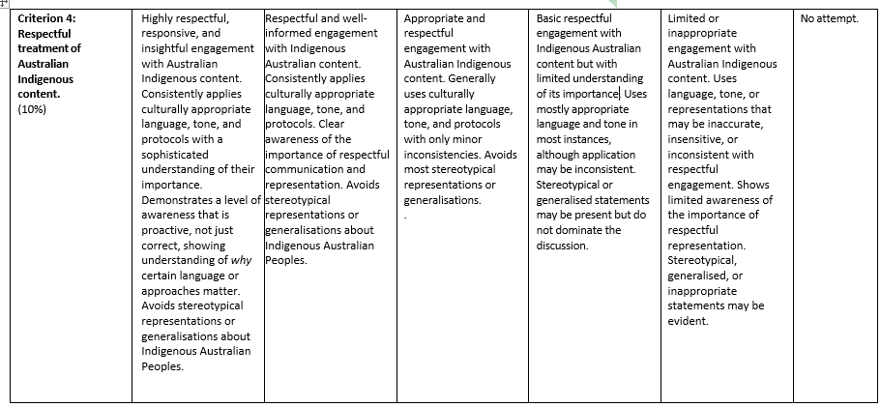
Rubric Assessment 1: Criterion 4

Slide 50
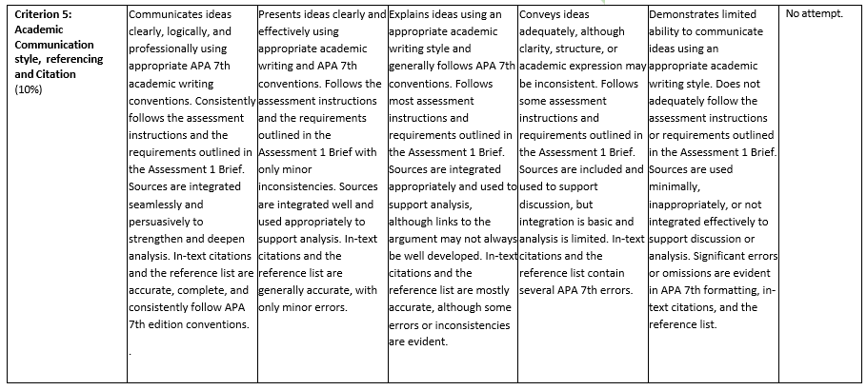
Rubric Assessment 1: Criterion 5

Slide 51
Questions?

Slide 52

Next Week:
Colonisation and health

